Slide 1
Software Design & Analysis
Project Presentation
Our Company Name: TechSphere
Our App Name: EduTech
Members:
I220793 – Kashf Khan
I220917 – Haqeeq Ruman
I221081 – Haniya Sajjad

Slide 2
Functional & Nonfunctional requirements
Functional:
The key objective is to develop a desktop application that meets the functional requirements of organizing and delivering academic resources, including study guides, online content, and assessments. Additionally, the app will support quizzes, with various formats like multiple-choice and theoretical, allowing students to test their knowledge in a focused manner.
Non-functional:
The non-functional requirements include ensuring the application is user-friendly, scalable for a large number of courses, and highly responsive. The system should offer fast content retrieval and smooth navigation between resources, maintaining a minimal learning curve for users.

Slide 3
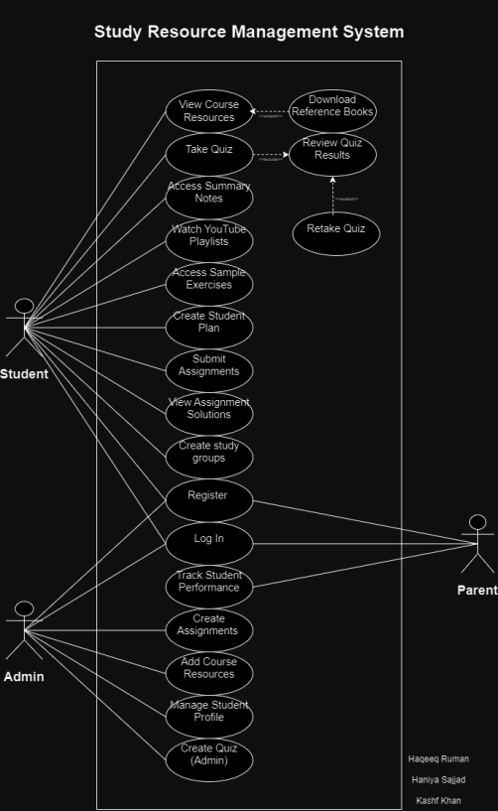
Use case diagram

Slide 4
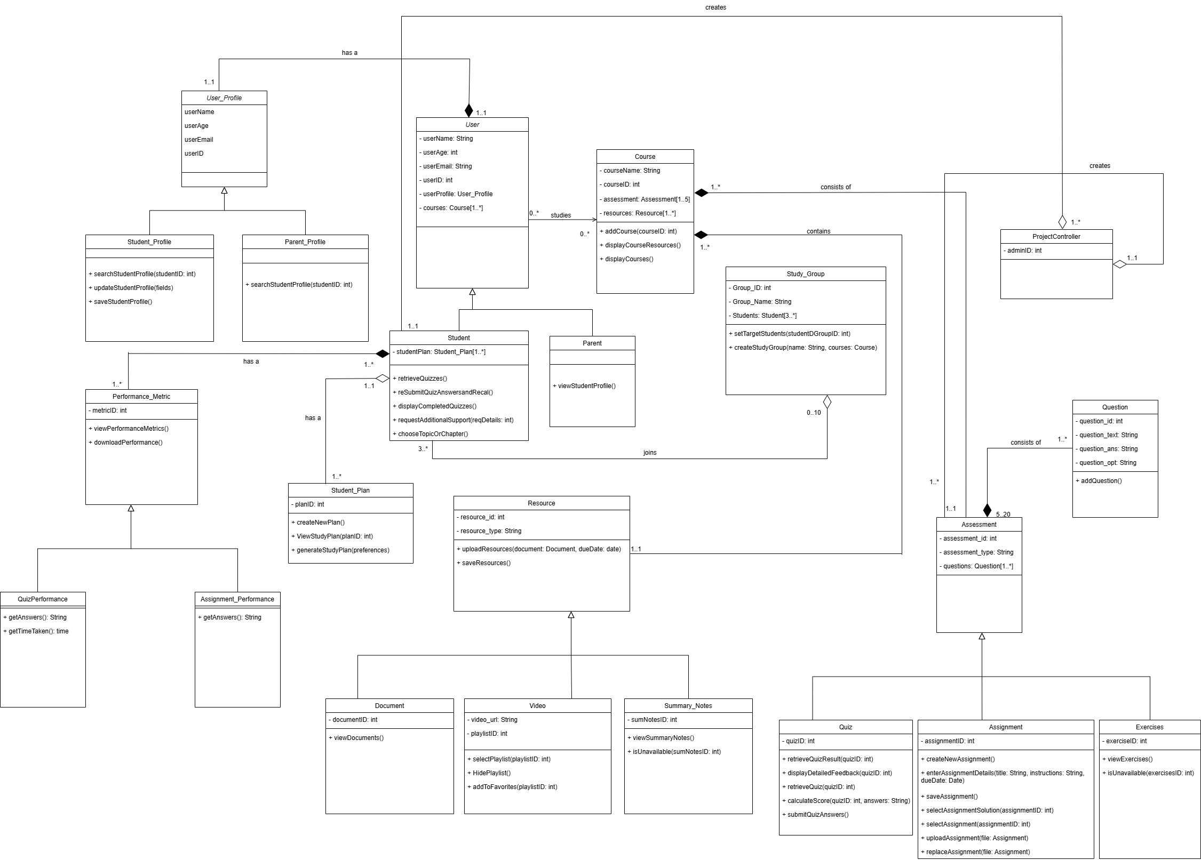
Class Diagram

Slide 5
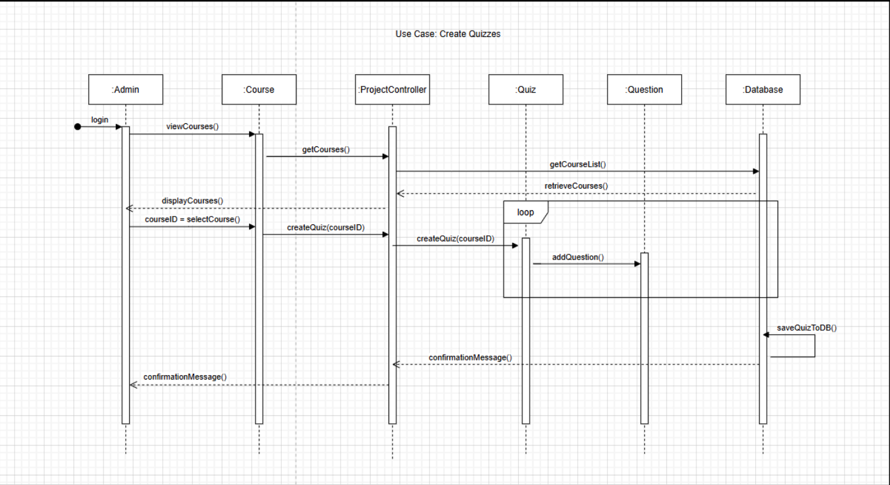
Sequence diagram
Create Quizzes

Slide 6
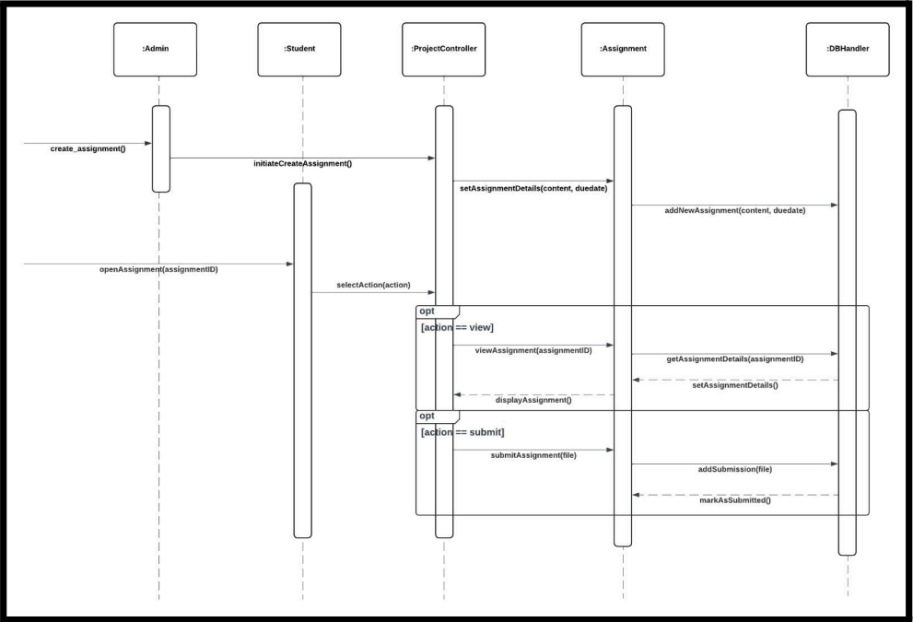
Sequence diagram
Create assignments

Slide 7
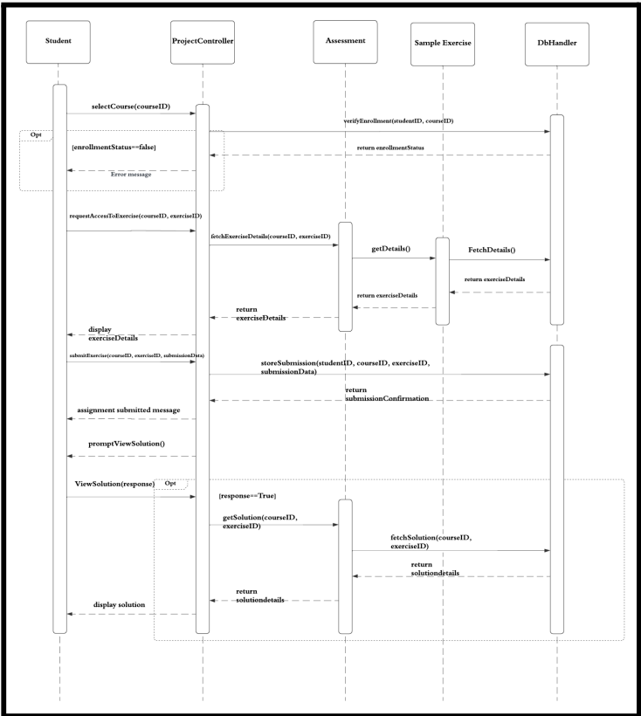
Sequence diagram
Attempt assignments

Slide 8
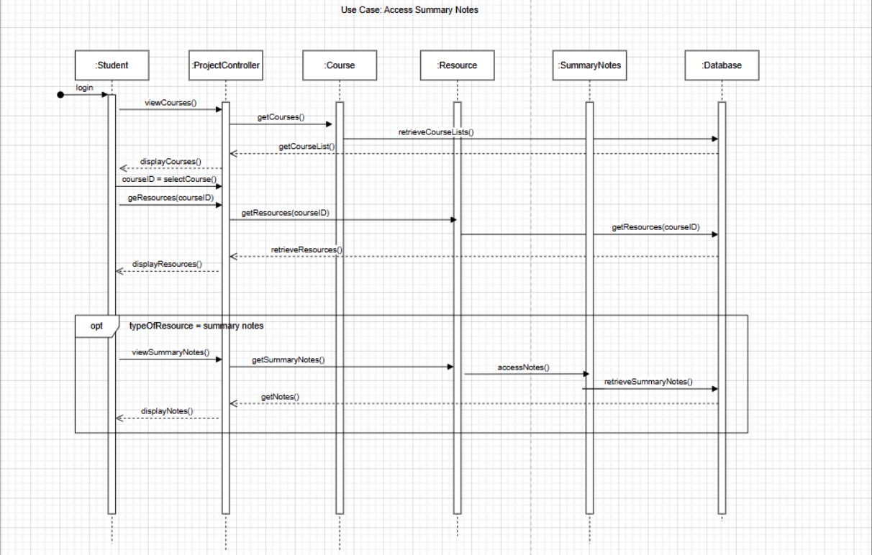
Sequence diagram
Access summary notes

Slide 9
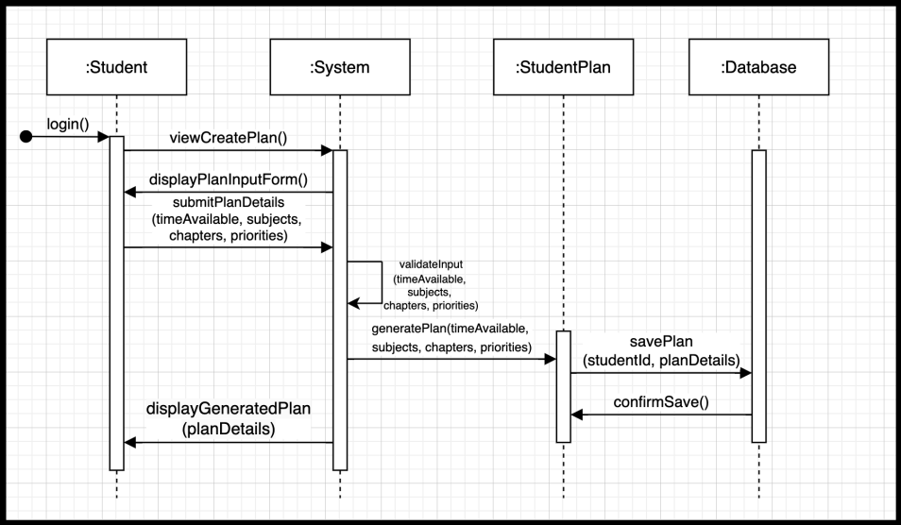
Sequence diagram
Create Student Plan

Slide 10
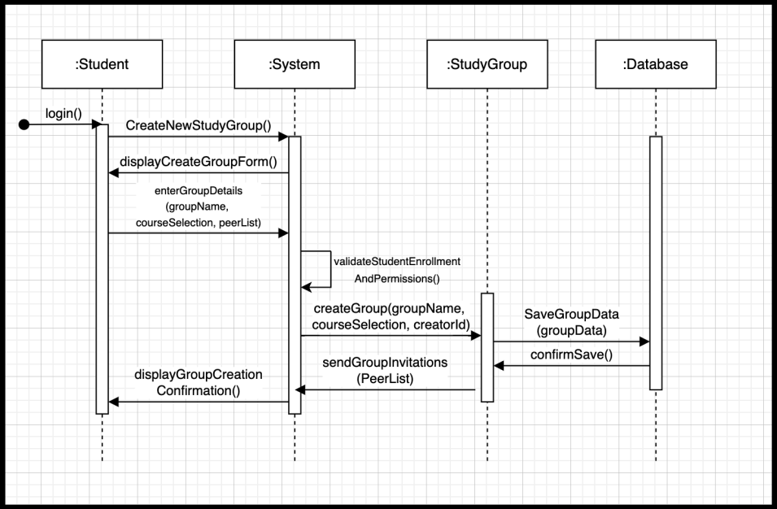
Sequence diagram
Create study groups

Slide 11
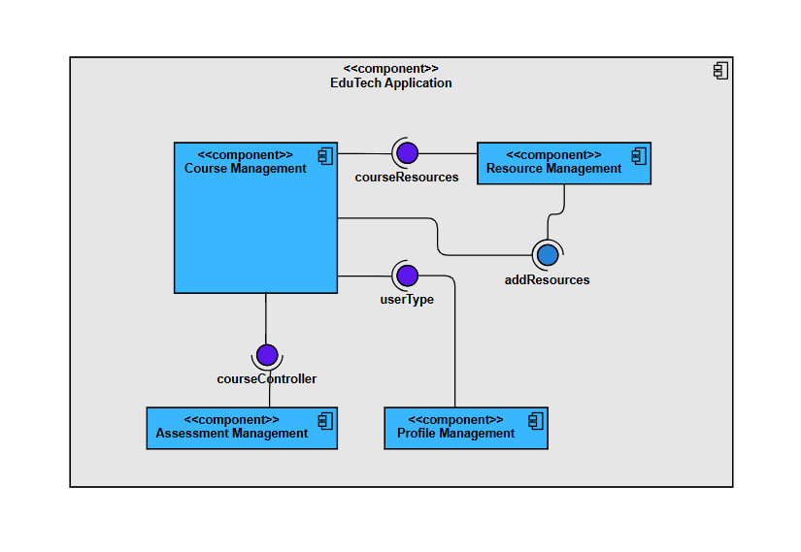
Component diagram

Slide 12
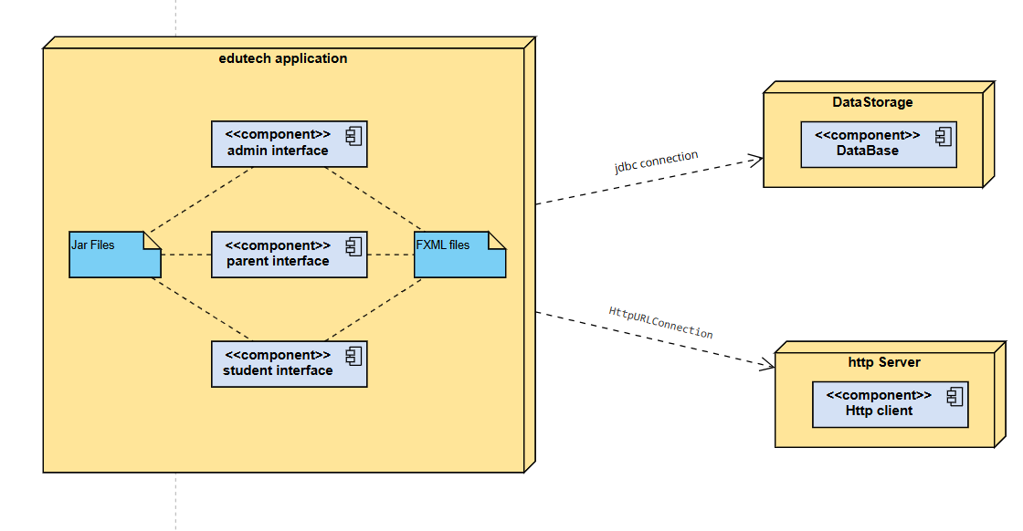
Deployment diagram

Slide 13
Design patterns
MVC Pattern: The system adheres to the Model-View-Controller paradigm. For example:
Model: Student, Resources, Assessments.
View: JavaFX .fxml files for UI design like LoginView.fxml.
Controller: Classes such as AuthController, AdminController, and CourseController handle the interaction between the UI and business logic layers.
Singleton Pattern: A singleton is used in DatabaseManager to ensure that there is only one instance managing the database connection at any given time.
Observer Pattern: Implemented for real-time updates where the Admin observes and updates information based on Student activity, such as performance tracking and resource usage.

Slide 14

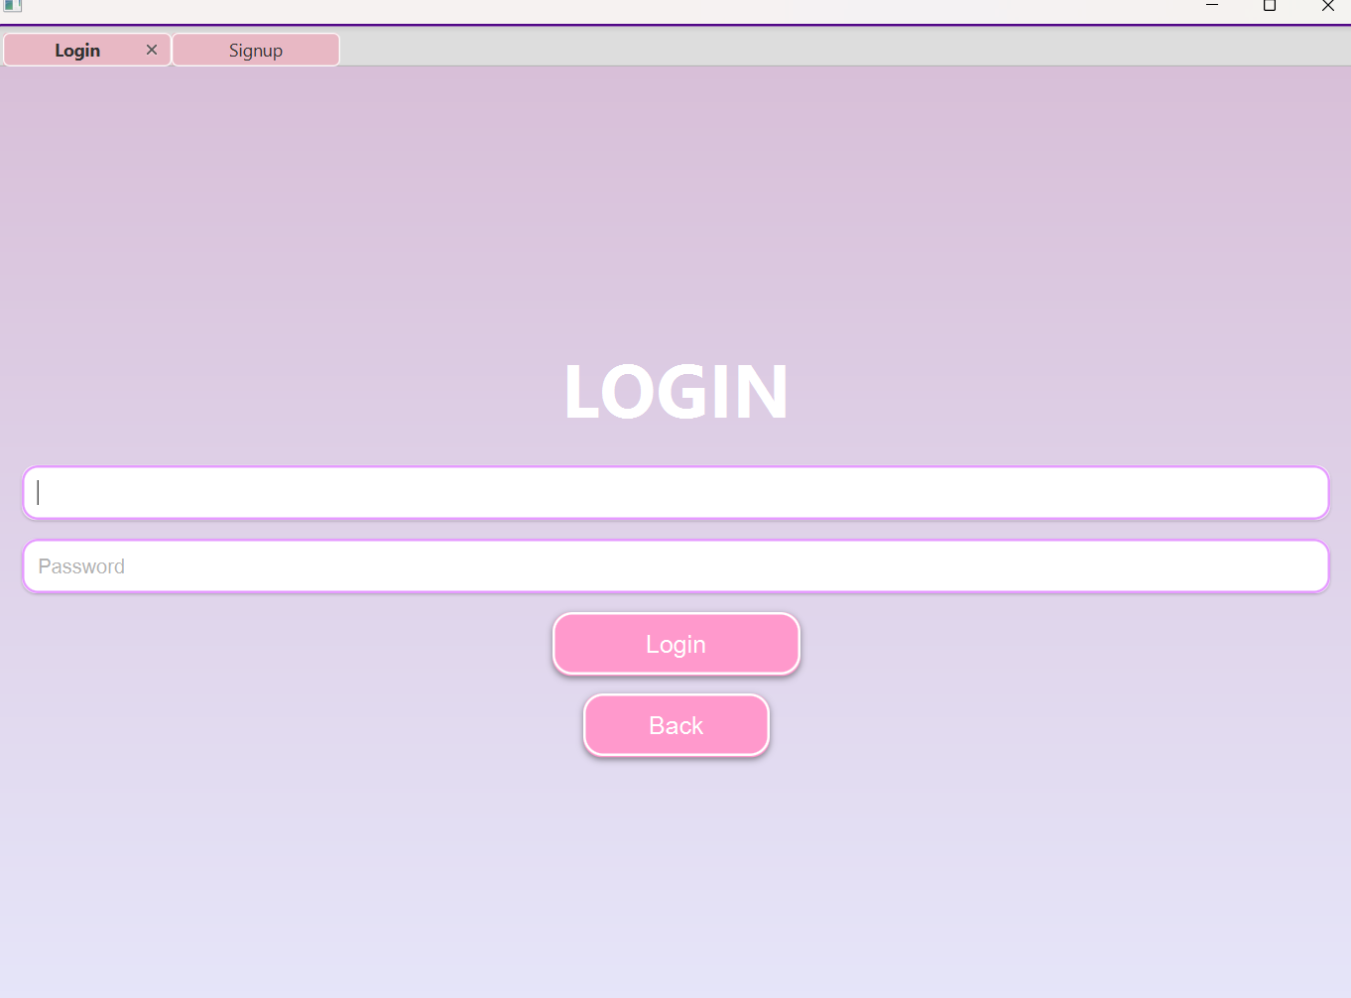
GUI
The first screen
The login screen

Slide 15
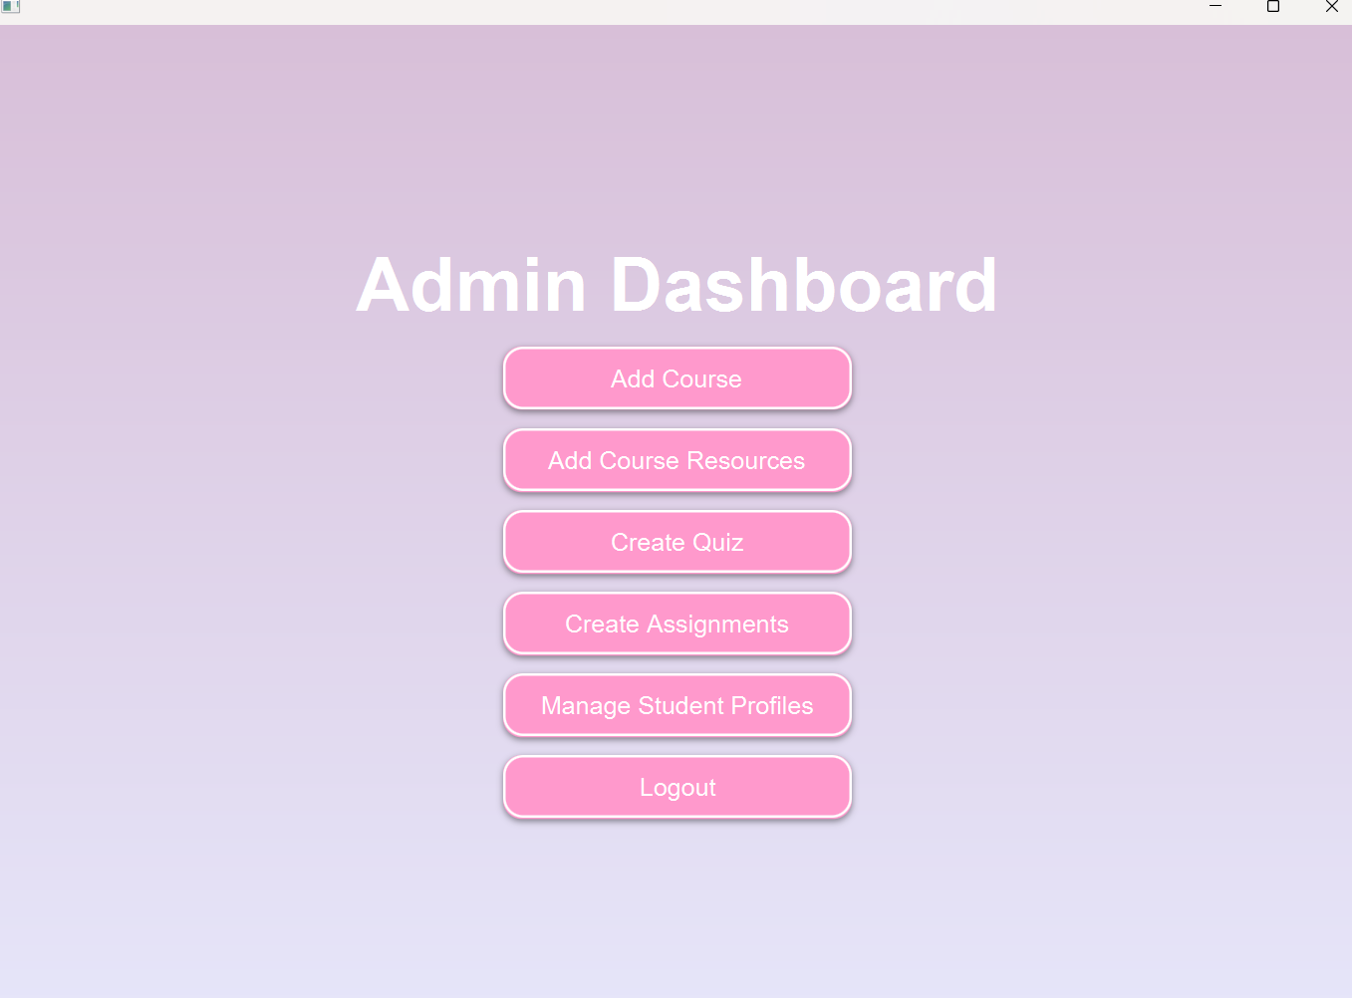
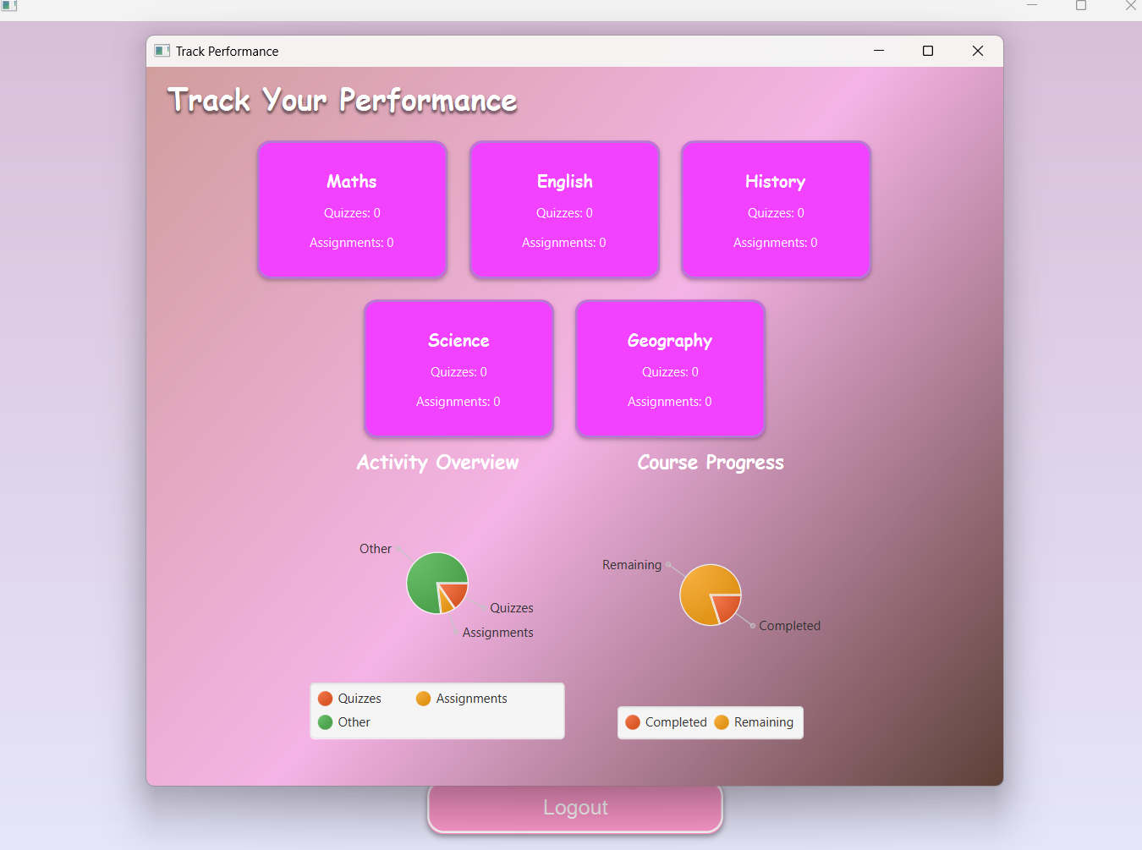
GUI
Admin Functions
Student Performance Tracker

Slide 16
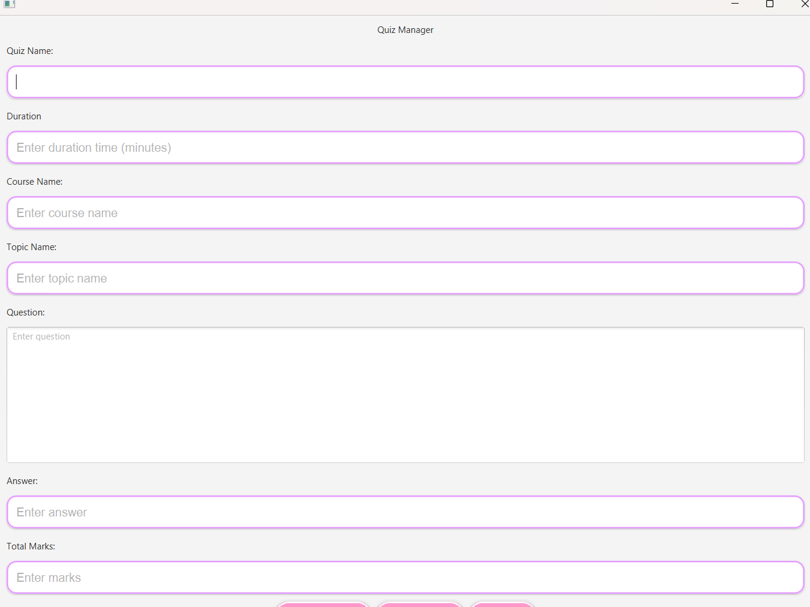
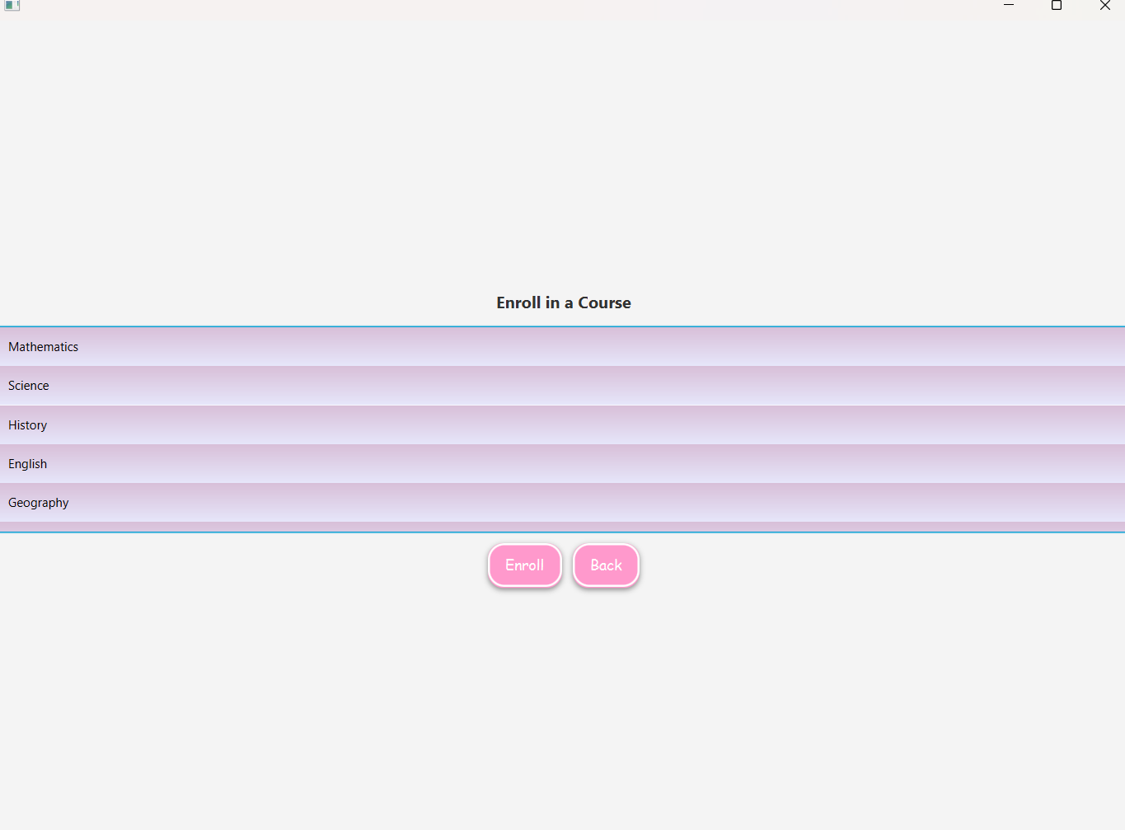
GUI
Selection of courses
Creation of Quizzes

